Slide 1
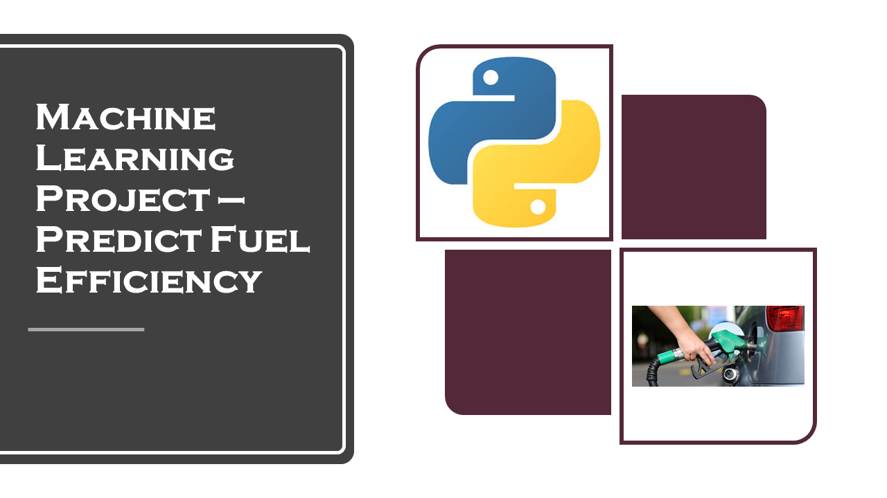
Machine learning project on average fuel consumption in vehicles

Slide 2
INTRODUCTION
This project aims to develop a machine learning model for predicting the average fuel consumption of vehicles based on various features. The dataset used comprises information such as vehicle design, model, year, engine size, weight, transmission type, fuel type, mileage, and other relevant factors. After preprocessing the data and conducting exploratory data analysis, including visualizing correlations and patterns, we employ feature engineering techniques to enhance model performance.
Several machine learning algorithms, including linear regression, decision trees, random forests, gradient boosting, and neural networks, are evaluated and compared using appropriate metrics such as mean squared error and mean absolute error. Hyperparameter tuning is employed to optimize the chosen model's performance.
The trained model not only provides accurate predictions of average fuel consumption but also offers insights into the factors that significantly influence fuel efficiency in vehicles. This project serves as a valuable tool for vehicle manufacturers, policymakers, and consumers to make informed decisions about vehicle design, usage patterns, and environmental impact, ultimately contributing to more sustainable transportation solutions.

Slide 3
ABSTRACT
This study proposes a machine learning approach to predict average fuel consumption in vehicles. With the rising demand for fuel-efficient transportation and the imperative to reduce carbon emissions, accurately estimating fuel consumption is crucial.
Leveraging a data set comprising vehicle specifications and driving conditions, various machine learning algorithms are employed, including regression-based models such as Linear Regression, Decision Trees, Random Forests, and Gradient Boosting. Feature engineering techniques are applied to extract relevant information, including engine size, vehicle weight, transmission type, and driving patterns.
The performance of each model is evaluated using metrics such as Mean Absolute Error (MAE) and Root Mean Squared Error (RMSE). Experimental results demonstrate the efficacy of the proposed models in accurately predicting average fuel consumption, thereby aiding in optimizing vehicle design and promoting sustainable transportation practices.

Slide 4
Queries ??

Slide 5
Thank you

